Slide 1


ESP Security Architecture
End-To-End API Access Security Flow Design – Due Date Change
Innovate
value-focused
digital & data solutions
At Speed.
Harmonize
alignment-focused organizational functions
At Scale.
Execute
customer-focused experiential services
With Confidence.

Slide 2

Enterprise Service Platform (ESP)
End-To-End API Access Security Flow Design – Due Date Change

Slide 3
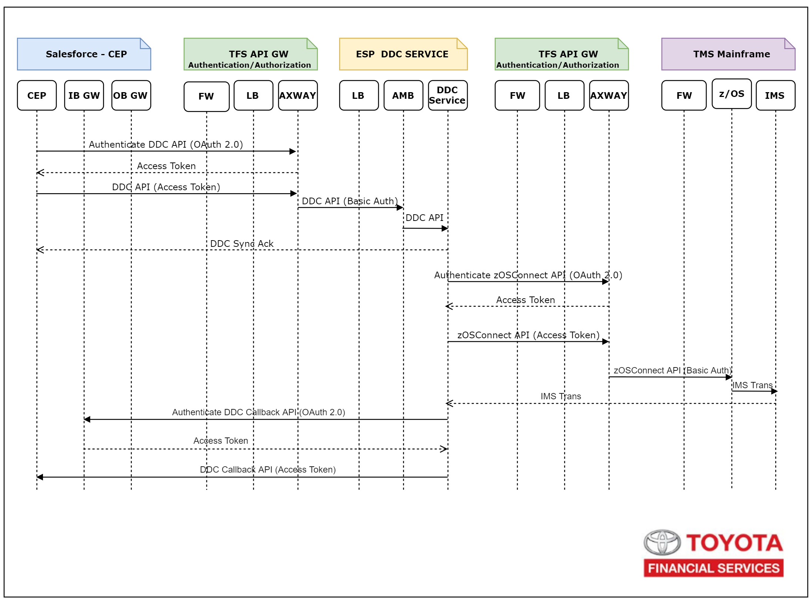
ESP Security Architecture: End to End API Security Flow
Cloud

Slide 4
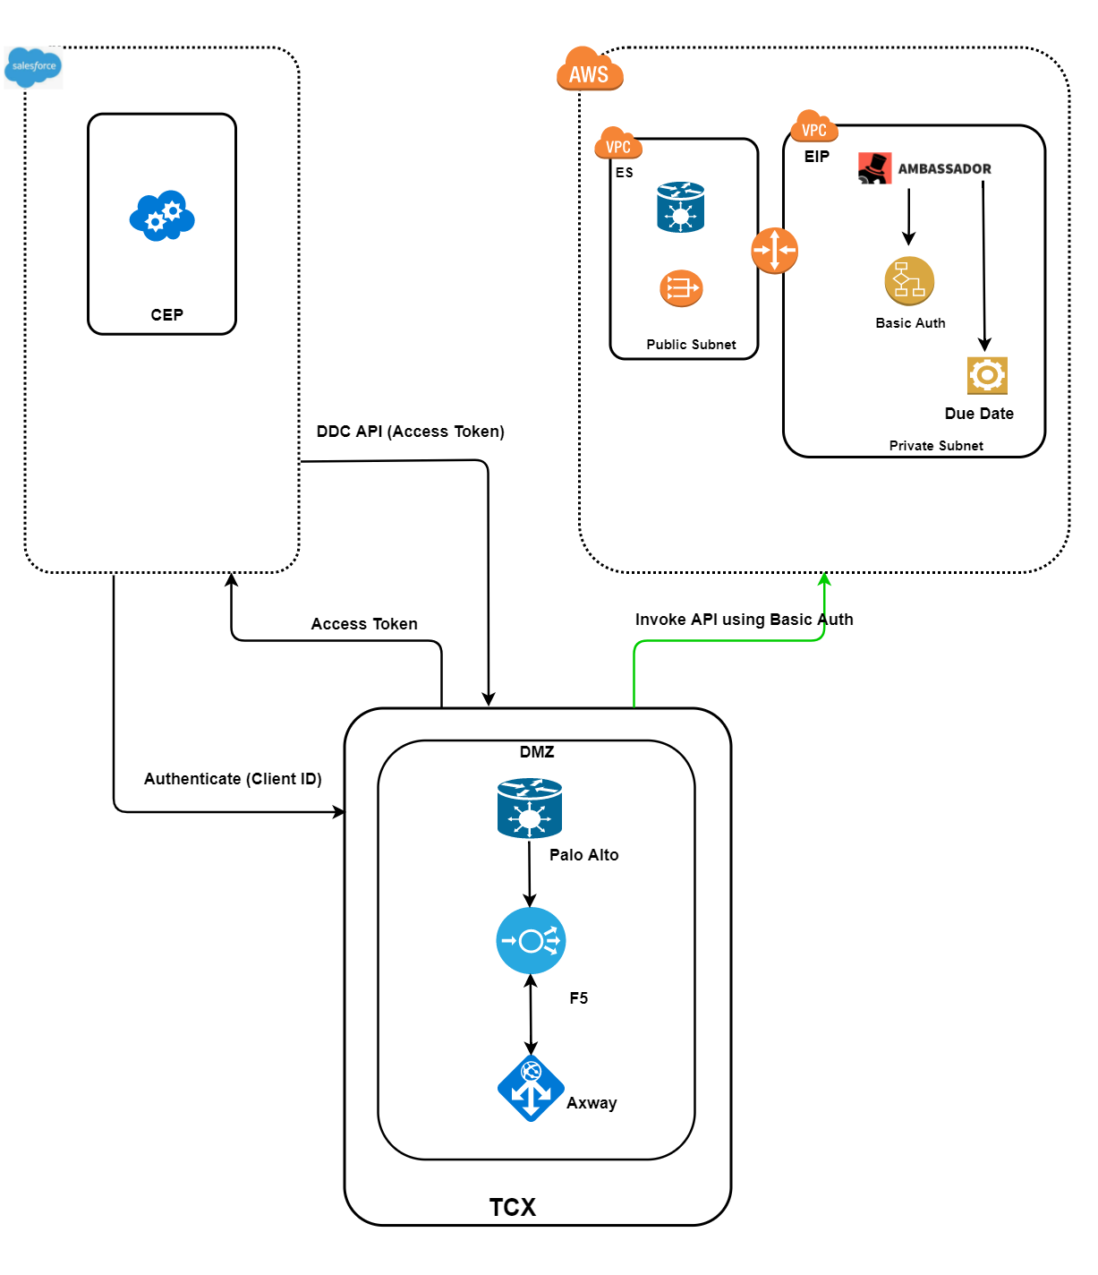
ESP Security Architecture: CEP to EIP API Flow
Sequence Flow
CEP: Authentication Request to Axway
Axway: Authentication Response with Access Token
CEP: Invoke Enterprise Due Data Change API with Access Token
Axway: Check CEP Authorization for Enterprise Due Date Change API
Axway: Forward Enterprise Due Date Change API Request to ESP with UserID & Credentials for Basic Auth
ESP: Execute Enterprise Due Date Change API and Return Response
Axway: Forward ESP Response to CEP
Cloud

Slide 5
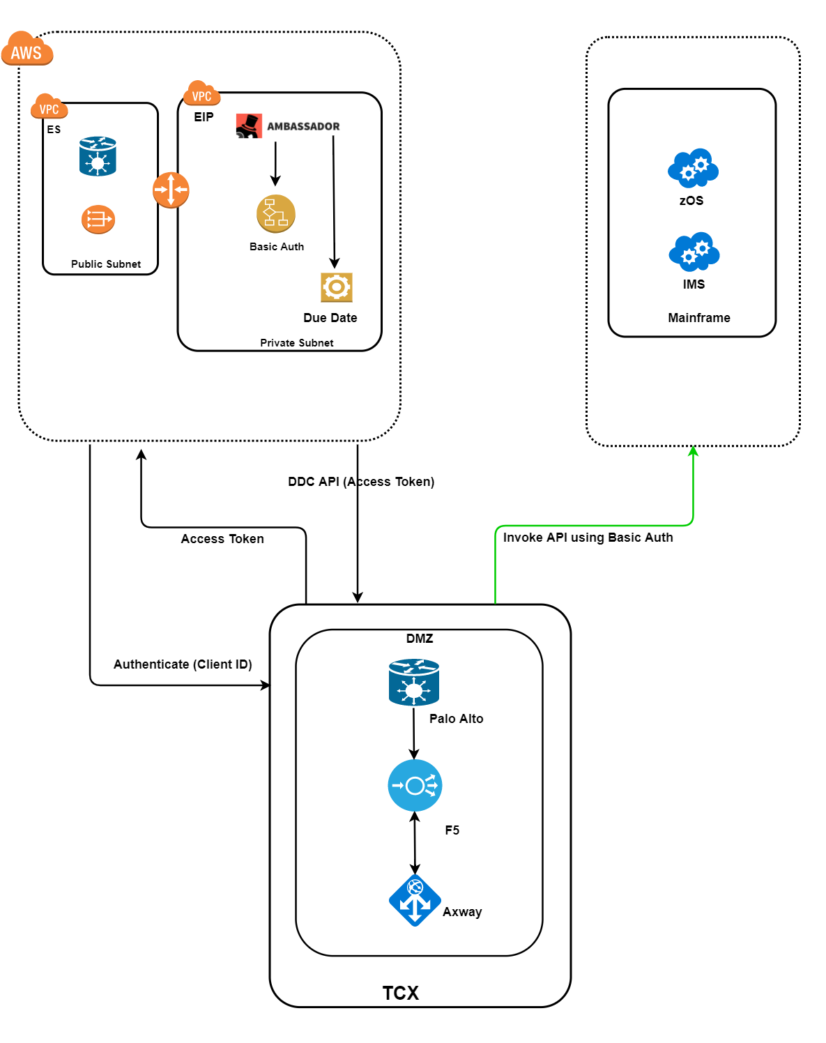
ESP Security Architecture: EIP to zOSConnect API Flow
Sequence Flow
ESP: Authentication Request to Axway
Axway: Authentication Response with Access Token
ESP: Invoke IMS Due Data Change API with Access Token
Axway: Check ESP Authorization for IMS Due Date Change API
Axway: Forward IMS Due Date Change API Request to zOSConnect with UserID & Credentials for Basic Auth
zOSConnect: Execute IMS Due Date Change API and Return Response
Axway: Forward zOSConnect Response to ESP
Cloud
Cloud

Slide 6
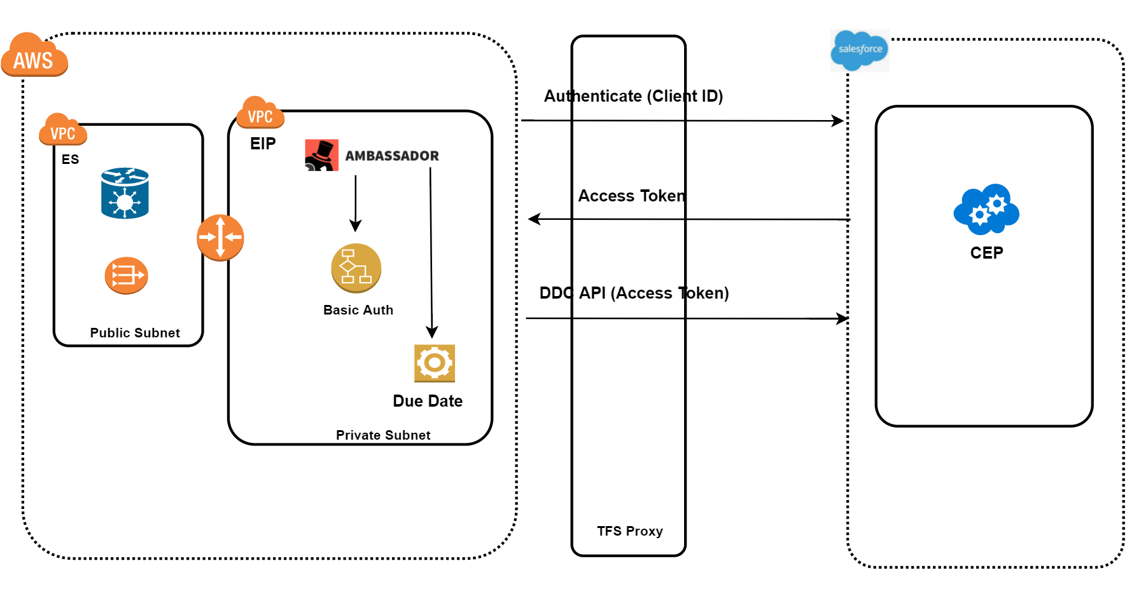
ESP Security Architecture: EIP to zOSConnect API Flow
Sequence Flow
ESP: Authentication Request to CEP
CEP: Authentication Response with Access Token
ESP: Invoke Due Data Change Callback API with Access Token
CEP: Check ESP Authorization for Due Date Change Callback API
CEP: Execute Due Date Change Callback API and Return Response to ESP
Cloud
Cloud

Slide 7

Copyright © 2012-2018 Steerwise Inc. All Rights Reserved.
Steerwise Inc. disclaims all warranties with regard to this material and contents herein, including all implied warranties of suitability and fitness for any particular purpose. In no event shall Steerwise Inc. be liable for any special, incidental, indirect or consequential damages or any damages whatsoever resulting from loss of use, data or profits, whether in an action of contract, negligence or other tortious action, arising out of or in connection with the use or inability to use this material or performance of this material.
Some contents in this material is protected by copyright, and permission must be obtained from the owner prior to any prohibited reproduction, storage in a retrieval system, or transmission in any form or by any means, electronic, mechanical, photocopying, recording or likewise. No one is allowed to remove or modify proprietary markings or proprietary legends, logos, trademarks, trade secrets, copyright and proprietary rights notices from this material under any circumstances.
The copyrighted material is intended for use by the licensed customers only. None of the information found here can be used for commercial gain of any kind including resale or reproduction for profit. No one is allowed to copy or sell or distribute any of the material or contents thereof or any derivate works to any party as their own, or of any other party, without explicitly obtaining either a commercial or non-commercial license from Steerwise Inc.
Business Technology Architecture® is a registered trademark of Steerwise Inc. Business Value First™, Innowise™, Alignwise™, Performwise™, Meaning-Oriented-Modeling™, Meaning-Oriented-Integration™, Business Being™, Data Efficacy & Data Excellence™, Data Semantic Analyzer™ are trademarks of Steerwise Inc.
Any inquiries regarding this material, requests for usage rights for the material or contents included herein, should be sent by email to info@steerwise.com

